Slide 1
CSCI 566: Deep Learning and Its Applications
Jesse Thomason
Lecture 3: Training NNs; CNNs

Slide 2
CSCI 566 Resources
Website: https://csci566-spring2023.github.io/
Piazza: https://piazza.com/usc/spring2023/csci566/info
GDrive: https://drive.google.com/drive/folders/11YcbSZcJUdRSbrNBWiOs_HM2VkxdNKWS?usp=share_link
Requires USC SSO; please don’t request access from your gmail account
Zoom: https://usc.zoom.us/j/95538924150?pwd=TTRBM283VCt4WDFkN1hLMmtrKzdGUT09

Slide 3
CSCI 566 Resources
Piazza: https://piazza.com/usc/spring2023/csci566/info
Please use Piazza for any course related communication
Course links:
Piazza → Resources → Course Information
If you’re new to the course, please fill Quiz 0 in the Resources tab of Piazza
Personal matters and emergency communication only:
csci566.spring2023@gmail.com
Any email that should have been a Piazza post will be ignored without acknowledgement

Slide 4
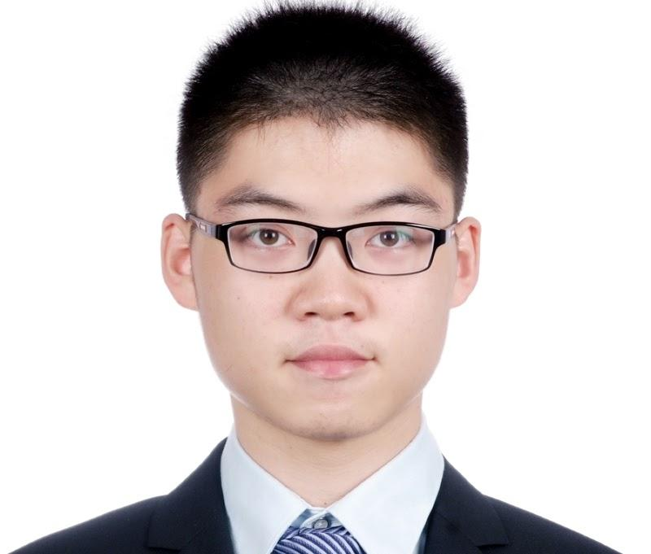
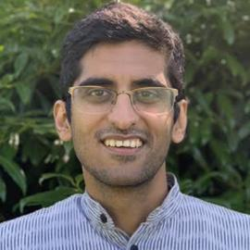






Course Office Hours
TA Office Hours
HW questions; project questions & feedback
Times available on the course website
Updates/changes to times announced on Piazza
Deqing Fu
Gautam Salhotra
Jesse Thomason
Instructor Office Hours
Mon 10am-11am
SAL 244
NOT for homework related questions.
Tejas Srinivasan
Bingjie Tang
Shihan Lu
Ayush Jain & Jesse Zhang

Slide 5
Course Deliverables
Deliverable | Points of the total grade
Pop-up Quizzes | 5
Assignment #1 | 10
Assignment #2 | 10
Paper Roleplaying Breakout | 10
Midterm | 20
Course Project | 45
TOTAL | 100
Project Deliverable | Points of the project grade
Project Proposal & Teaming | 2
Project Pitch | 1
Project survey | 5
2 meetings with TA | 2
Project Mid-report | 12
Final Presentation | 8
Final Report | 15
TOTAL | 45

Slide 6
Course Project Team Registration
Project 4-person teams are due today; Feb 3rd, 11:59pm
There is a team registration form online
Piazza → Resources → Course Project
Only ONE person from each team should submit this form
Each person in the room should be on exactly one team
For the research project:
You may not work with students outside this course.
You may not share code with other teams in the course.
You must enumerate individual contributions of your four team members in reports.

Slide 7
Course Project
Select from provided project ideas
https://docs.google.com/document/d/1bQusP0uS8KoVk7ZmxpGs209gBD3N9p-aSzMTTM63k1k/
This is a living document; more project ideas might trickle in since we have new TAs. You can pivot your project until the proposal; the registration tentative title is to help us pick a guiding TA for your team
Or design your own project, using the project ideas doc as an outline for what you should include in your proposal slide deck

Slide 8
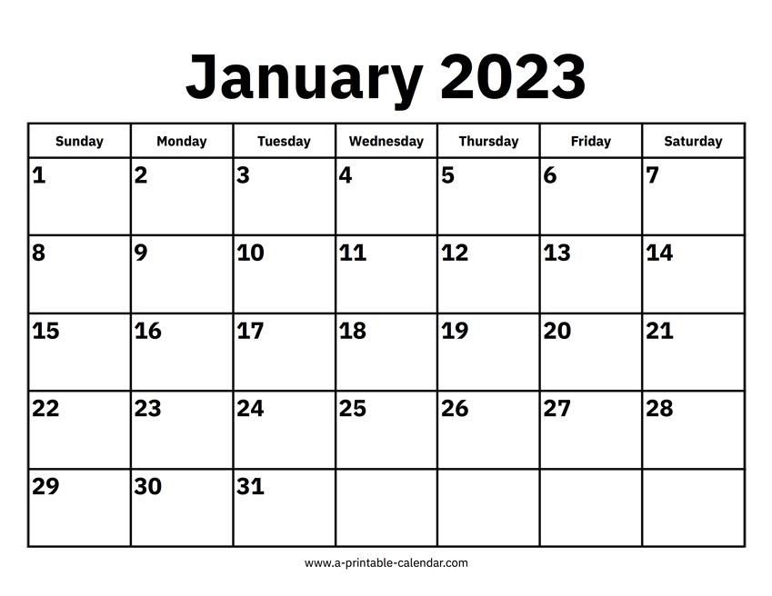
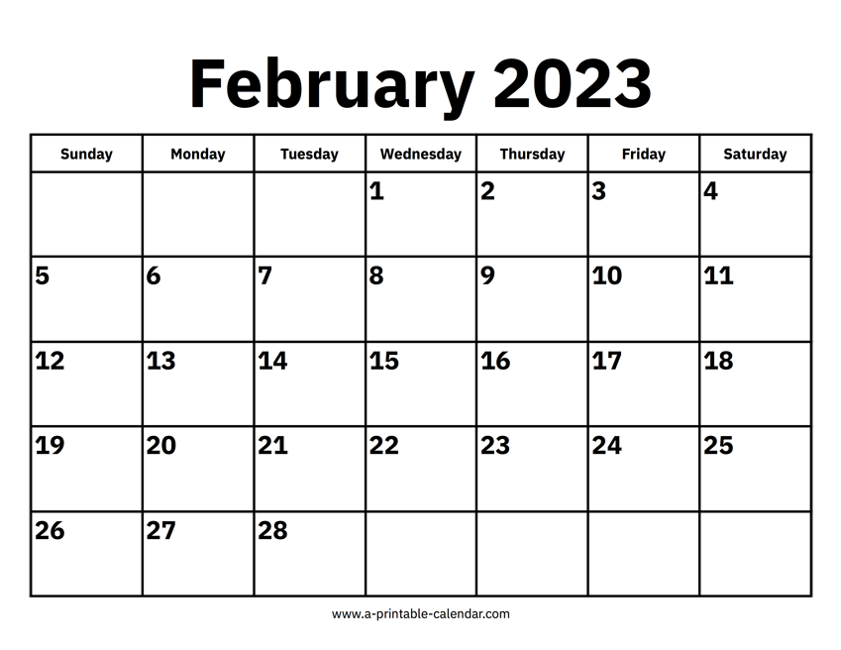

Map to the Midterm
Module 1: Neural Network Basics

Slide 9
[Feb 3] A Look at February Deliverables
Project Teams Formed | Feb 3
Assignment 1 Out | Feb 10
Project Proposal Due | Feb 17
Assignment 1 Due | Feb 24
Midterm Exam | Feb 24

Slide 10
Thinking Ahead: Course Project Proposal [Feb 17]
Proposal: 5-6 slides on problem (scope & definition) + "today" (status of literature) + challenges + directions to innovate.
Look at the project ideas doc populated by the TAs to get a sense of what material your proposal should cover for problem definition and background
Include what you hope to be your key insight or contribution; what will make your approach unique?
We will share a link to collect the slides.
You will condense these longer, more detailed slides into a single lightning pitch slide for the Project Pitch assignment.

Slide 11
Course Compute
We have both CARC and Google Cloud Platform credits for the course
Next week in class, the TAs will lead a tutorial session during our lecture slot on using these cloud platforms
Additionally, the TAs will lead a tutorial session on the PyTorch deep learning framework
TA tutorial sessions will be valuable both for your course projects and for preparing to do the Coding Assignments

Slide 12
Overview of Today’s Plan
Course organization and deliverables
Any questions before we move on?
Training Neural Networks
Convolutional Neural Networks

Slide 13
f: X ✕ Θ → Y;
f(x;θ)=y; θ∈Θ for model M
f: X → Y;
f(x)=y
f: ɸ_{x}(X) ✕ Θ → ɸ_{y}(Y);
f(x;θ)=y
f: ɸ_{x}(X) → ɸ_{y}(Y);
f(x)=y
DL enables function approximation for f and is constrained by:
Data representation ɸ
Model architecture M
Loss function L
Optimization algorithm
Training data D
θ*=min_{θ∈Θ}(Σ_{(x,y)}L(f(x;θ), y)))
θ*=min_{θ∈Θ}(Σ_{(x,y)∈D}L(f(x;θ), y)))

Slide 14
Where Does Data D Come From?
We’ve been assuming access to a dataset of (X, Y) to calculate the difference between y_{i} and f(x_{i};θ) for (x_{i},y_{i})∈(X, Y)
Supervised learning:
For all training data x_{i} we know the correct label y_{i}
Unsupervised learning:
For no training data x_{i} do we have an associated label
Weakly-supervised learning:
For a (usually small) subset of x_{i} we have label y_{i}
Reinforcement learning:
In sequential problems, we don’t have labels for individual predictions but get a reward for the final sequence

Slide 15
How Do We Measure the Quality of f(x;θ) ?
How do we measure the fit of candidate parameters?
Want to formulate an optimization problem to minimize the distance {f*(x) - f(x;θ)} across all x_{i}∈X in a dataset of (X, Y) pairs
We call the function we want to minimize, subject to the available training data, the loss function
What are some possible ways to measure such a distance penalty? We want “good” θ to have less loss than “bad” θ

Slide 16
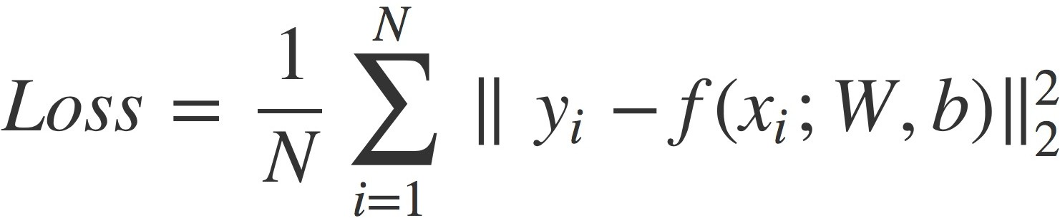
How Do We Measure the Quality of f(x;θ) ?
We could add a quadratic penalty
This loss function is called L₂ Loss
What could go wrong?
The model doesn’t have a strong incentive to get f “exactly” right; for terms less than 1 the square makes them less severe
Not getting f exactly right isn’t such a bad thing!

Slide 17
How Do We Find Good Parameters θ for f(x;θ) ?
f(x;θ)=Wx+b; θ={W,b}
θ*=min_{θ∈Θ}(Σ_{(x,y)∈D}L(f(x;θ), y)))
For D={(x₁,y₁), (x₂,y₂), …, (x_{n},y_{n})} our training dataset
Three basic classes of approach:
Analytical solution
Find where ^{d}/_{dθ} (Σ_{(x,y)∈D}L(f(x;θ), y))) = 0
Heuristic search
Initialize random candidate θ’s and check L value
Numerical approach
Estimate better θ’s given current ones

Slide 18
How Do We Find Good Parameters θ for f(x;θ) ?
f(x;θ)=Wx+b; θ={W,b}
θ*=min_{θ∈Θ}(Σ_{(x,y)∈D}L(f(x;θ), y)))
For D={(x₁,y₁), (x₂,y₂), …, (x_{n},y_{n})} our training dataset
Numerical approach
Estimate better θ’s given current ones
Best of both worlds: cheap (heuristic) + informed (analytical)
Finding where ^{d}/_{dθ} (Σ_{(x,y)∈D}L(f(x;θ), y))) = 0 is hard
Finding good θ through random/population search is hard
Calculating ^{d}/_{dθi} (Σ_{(x,y)∈D}L(f(x;θ), y))) for dimension θ_{i} is easy…

Slide 19
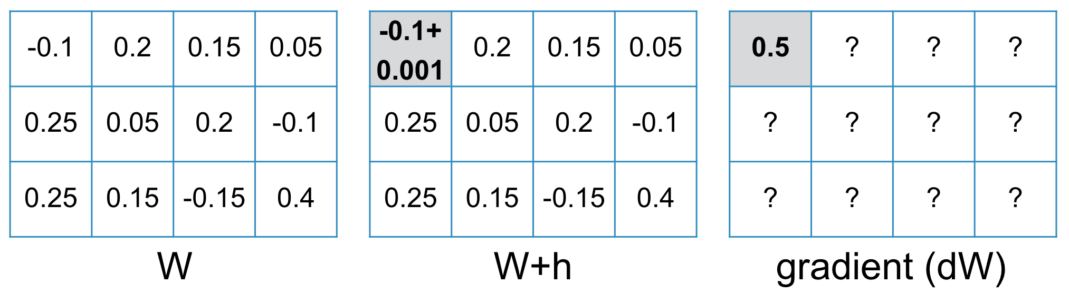
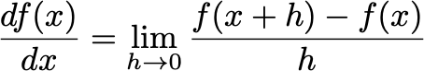
Gradient Descent
L(W) = 1.6688
L(W+h) = 1.6693
dW₁=(1.6693 - 1.6688) / 0.001
= 0.5

Slide 20
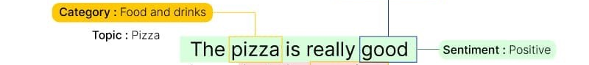
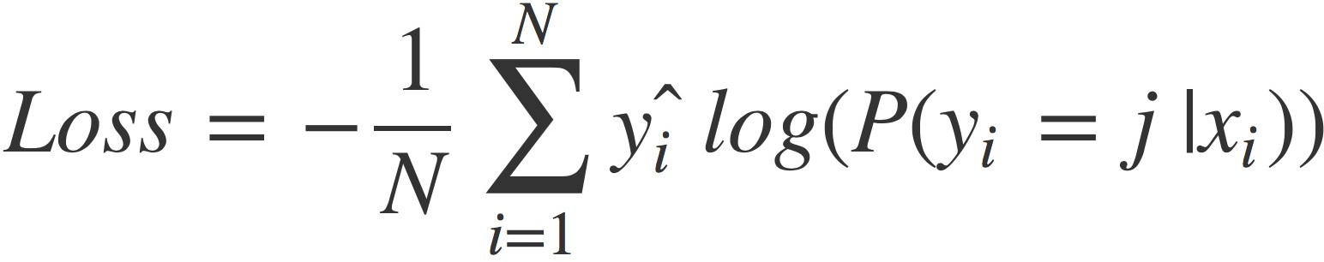
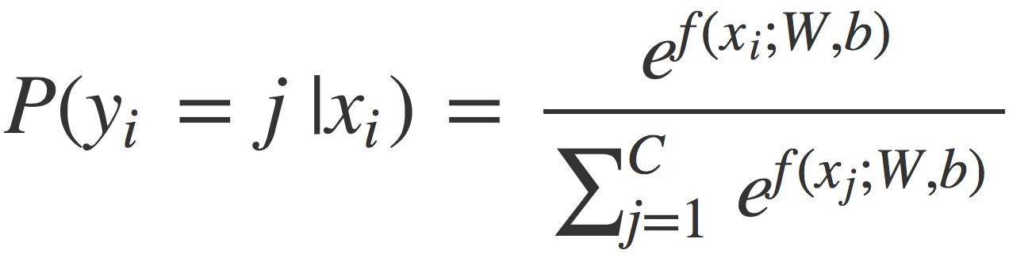
Formulating a Problem for Machine Learning
Input space X?
Review tokens T
X=T^{N} for max length N
Output space Y?
Possible sentiments S
Y=S
Linear function: f(x,θ)=Wx+b
What loss function could we use for this n-ary classification problem?
Cross entropy
Non-linear transformation:

Slide 21
f(x;θ)=𝝈(Wx+b )
ɸ_{x}(x)=x
Wx
b
Wx+b
𝝈(Wx+b)
Each output i is a weighted combination of inputs.
Each output i is the sum of Wx and bias b of len i
Each output i is exp(v) over sum of all exp(v); forms probability distribution

Slide 22
Where Does Deep Learning Come In?
Linear function: f(x,θ)=Wx+b
What loss function could we use for this n-ary classification problem?
Cross entropy
Non-linear transformation:
Our function can only capture the degree to which each dimension of the input, x_{i}, contributes to the likelihood of each class y_{j}
“... brought out the ice cold food.”
“... brought out the ice cold gazpacho.”
“... Amazing service all around. Yeah right! 🙃”

Slide 23
Where Does Deep Learning Come In?
Quick terminology note, these basic transformations are called perceptron layers / fully-connected layers
f(x,θ)=𝝈(Wx+b)
Linear function with non-linear, sigmoid activation
If we need to make decisions considering interplay between multiple x_{i} input features, what can we change in our function?
f(x,θ)=𝝈(W₂(𝝈(W₁x+b₁))+b₂)
First layer latent variables 𝝈(W₁x+b₁)) are each activated by linear combination of values of x_{i} input variables
Now W₂,b₂ can mix signals from the first layer; the final outputs 𝝈(W₂(𝝈(W₁x+b₁))+b₂) are each activated by linear combinations of the latent variables from layer one
So our class logits can now consider combinations of input words like “cold gazpacho” and “Amazing … Yeah right!”

Slide 24
f(x,θ)=𝝈(W₂(𝝈(W₁x+b₁))+b₂)
W₂(𝝈(W₁x+b₁))+b₂
ɸ_{x}(x)=x
W₁x
W₁x+b₁
𝝈(W₁x+b₁)
W₂(𝝈(W₁x+b₁))
𝝈(W₂(𝝈(W₁x+b₁))+b₂)
b₁
b₂

Slide 25
Neural Networks as Function Composition; 𝝈(W₁x+b₁)
exp(W_{1,1}x₁+W_{1,2}x₂+b₁) / (exp(W_{1,1}x₁+W_{1,2}x₂+b₁)+exp(W_{2,1}x₁+W_{2,2}x₂+b₂))
x₁
W_{1,1}x₁+W_{1,2}x₂
W_{1,1}x₁+W_{1,2}x₂+b₁
exp(W_{2,1}x₁+W_{2,2}x₂+b₂) / (exp(W_{1,1}x₁+W_{1,2}x₂+b₁)+exp(W_{2,1}x₁+W_{2,2}x₂+b₂))
x₂
W_{2,1}x₁+W_{2,2}x₂
W_{2,1}x₁+W_{2,2}x₂+b₂
b₁
b₂

Slide 26
Forward Pass
In this function, if loss is high, what can we change to make it lower?
exp(W_{1,1}x₁+W_{1,2}x₂+b₁) / (exp(W_{1,1}x₁+W_{1,2}x₂+b₁)+exp(W_{2,1}x₁+W_{2,2}x₂+b₂))
x₁
W_{1,1}x₁+W_{1,2}x₂
W_{1,1}x₁+W_{1,2}x₂+b₁
exp(W_{2,1}x₁+W_{2,2}x₂+b₂) / (exp(W_{1,1}x₁+W_{1,2}x₂+b₁)+exp(W_{2,1}x₁+W_{2,2}x₂+b₂))
x₂
W_{2,1}x₁+W_{2,2}x₂
W_{2,1}x₁+W_{2,2}x₂+b₂
Loss function; high when our outputs are far from desired vector, low when they’re close to desired vector.
b₁
b₂

Slide 27
NNs are Parameterized, Compositional Functions
exp(W_{1,1}x₁+W_{1,2}x₂+b₁) / (exp(W_{1,1}x₁+W_{1,2}x₂+b₁)+exp(W_{2,1}x₁+W_{2,2}x₂+b₂))
x₁
W_{1,1}x₁+W_{1,2}x₂
W_{1,1}x₁+W_{1,2}x₂+b₁
exp(W_{2,1}x₁+W_{2,2}x₂+b₂) / (exp(W_{1,1}x₁+W_{1,2}x₂+b₁)+exp(W_{2,1}x₁+W_{2,2}x₂+b₂))
x₂
W_{2,1}x₁+W_{2,2}x₂
W_{2,1}x₁+W_{2,2}x₂+b₂
Loss function; high when our outputs are far from desired vector, low when they’re close to desired vector.
b₁
b₂

Slide 28
Backwards Pass
exp(W_{1,1}x₁+W_{1,2}x₂+b₁) / (exp(W_{1,1}x₁+W_{1,2}x₂+b₁)+exp(W_{2,1}x₁+W_{2,2}x₂+b₂))
x₁
W_{1,1}x₁+W_{1,2}x₂
W_{1,1}x₁+W_{1,2}x₂+b₁
exp(W_{2,1}x₁+W_{2,2}x₂+b₂) / (exp(W_{1,1}x₁+W_{1,2}x₂+b₁)+exp(W_{2,1}x₁+W_{2,2}x₂+b₂))
x₂
W_{2,1}x₁+W_{2,2}x₂
W_{2,1}x₁+W_{2,2}x₂+b₂
Loss function; high when our outputs are far from desired vector, low when they’re close to desired vector.
b₁
How do we calculate the gradient update of each parameter starting at the end with the loss?
b₂

Slide 29
We Can Employ a Computation Graph
Consider function: f(x,y,z) = x*y + z
x
*
y
+
f
z
Notes:
TODO note: change internal function to h for this example to avoid double f notation

Slide 30
Employ a Computation Graph
Consider function: f(x,y,z) = x*y + z
-3
x
-15
*
5
-13
y
+
f
2
z

Slide 31
We need to be able to take partial derivatives
L(W) = 1.6688
L(W+h) = 1.6693
dW₁=(1.6693 - 1.6688) / 0.001
= 0.5

Slide 32
Backpropagation via Computation Graph
Consider function: f(x,y,z) = x*y + z
-3
x
NNs are compositions of functions
Let’s define:
g(x,y) = x*y
f(g,z) = g + z
-15
g
*
5
-13
f
y
+
f
2
z

Slide 33
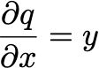
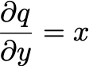

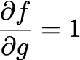
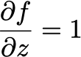
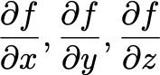
Backpropagation via Computation Graph
f(x,y,z) = x*y + z
g(x,y) = x*y; f(g,z) = g+z
-3
x
Let x,y,z be parameters we want to update
Then we need:
-15
g
*
5
-13
f
y
+
f
2
z

Slide 34
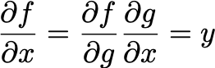
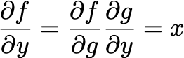
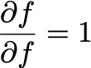
Backpropagation via Computation Graph
f(x,y,z) = x*y + z
g(x,y) = x*y; f(g,z) = g+z
-3
x
Let x,y,z be parameters we want to update
Then we need:
5
-15
g
*
1
5
-13
f
y
+
f
-3
1
2
z
1

Slide 35
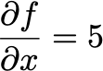
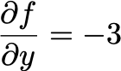
Backpropagation via Computation Graph
f(x,y,z) = x*y + z
g(x,y) = x*y; f(g,z) = g+z
-3
x
Then we get:
5
-15
g
*
1
5
-13
f
y
+
f
-3
1
2
z
1

Slide 36
Backpropagation with a Loss Function
f(x,y,z) = x*y + z
g(x,y) = x*y; f(g,z) = g+z
-3
x
If f is just our predictor, we can add a loss on top, call it function L
L(f)
5
-15
g
*
1
5
-13
f
y
+
f
L
-3
1
2
z
1

Slide 37
Backpropagation with a Loss Function
f(x,y,z) = x*y + z
g(x,y) = x*y; f(g,z) = g+z
-3
x
Forward pass
Backwards pass
-15
g
*
5
-13
-13
f
y
+
f
L
The loss function L and every component of the forward function f need to be differentiable for backprop
2
z

Slide 38
Backpropagation with Branches
Gradients add at branches
Enables single input to function as part of multiple outputs
E.g.,
Multiple loss functions
“Skip” connections
+
+
x
+

Slide 39
Backpropagation with a Computation Graph
Consider model: M(x,W) = Wx with learnable params W
Let’s use the L2 loss function
Then:
W
⋅
L
f
x

Slide 40
Backpropagation with a Computation Graph
Learnable params
Forward pass
Backwards pass
0.38
0.29
0.4 | 0.6
0.7 | -0.2
W
0.2285
⋅
L
f
0.5
0.3
x

Slide 41
We need to be able to take partial derivatives
L(W) = 1.6688
L(W+h) = 1.6693
dW₁=(1.6693 - 1.6688) / 0.001
= 0.5

Slide 42
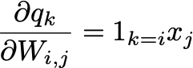
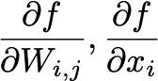
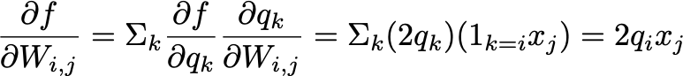
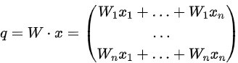
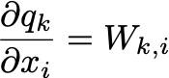
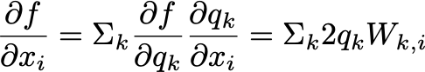
Backpropagation with a Computation Graph
We want:
Define:
Rewrite:

Slide 43
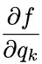
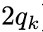
Backpropagation with a Computation Graph
Learnable params
Forward pass
Backwards pass
0.38
0.29
0.4 | 0.6
0.7 | -0.2
W
0.2285
⋅
L
f
0.5
0.3
1
x
0.76
0.58

Slide 44
Backpropagation with a Computation Graph
Learnable params
Forward pass
Backwards pass
0.38 | 0.228
0.29 | 0.174
0.38
0.29
0.4 | 0.6
0.7 | -0.2
W
0.2285
⋅
L
f
0.5
0.3
1
x
0.76
0.58
0.71
0.34

Slide 45
Backpropagation with a Computation Graph
Now we can take a gradient step
Let learning rate be 0.1, then:
0.4 | 0.6
0.7 | -0.2
0.38 | 0.228
0.29 | 0.174
0.362 | 0.5772
0.671 | -0.2174
W
0.1*
=
0.5
0.3
0.71
0.34
0.429
0.266
x
0.1*
=

Slide 46
Backpropagation with a Computation Graph
Learnable params
Forward pass
Backwards pass
Rather than adding tiny noise to every param and calculating the loss difference, we calculate partial derivatives of systems of equations for more efficient learning!
0.309
0.230
0.362 | 0.5772
0.671 | -0.2174
W
0.1484 < 0.2285
⋅
L
f
0.429
0.266
x

Slide 47
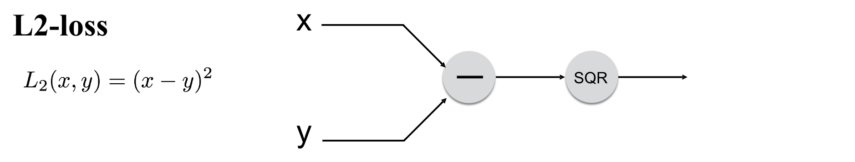
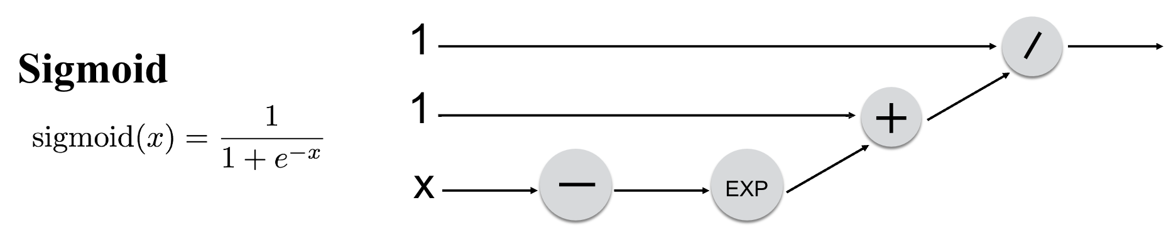
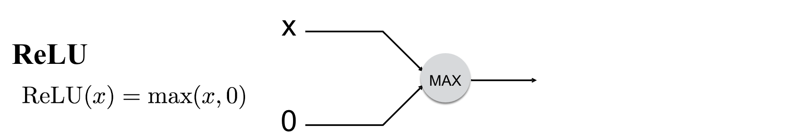
Computation Graph Non-Linearities

Slide 48






























Recap: Forward and Backward Propagation
X
Y

Slide 49
Recap: Forward and Backward Propagation
Forward Propagation
Loss L
X
Y
Compute a loss using an estimated Y and the ground truth Y*. e.g., L(W) = || f(X; W) - Y* ||₂

Slide 50
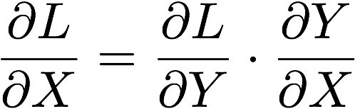
Recap: Forward and Backward Propagation
Backward Propagation
∇L
X
∇Y
Compute gradients of Y using ∇L.

Slide 51
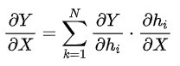
Recap: Forward and Backward Propagation
d h₁/ dx
Backward Propagation
d h₂/ dx
∇L
X
∇Y
Chain rule

Slide 52
Recap: Forward and Backward Propagation
d g₁/ dx
d h₁/ dx
Backward Propagation
d h₂/ dx
∇L
d h₃/ dx
X
∇Y
d h₄/ dx
d h₅/ dx

Slide 53
Recap: Forward and Backward Propagation
The loss function drives back propagation; without calculating loss, we’re just making predictions (e.g., forward pass)
A computation graph describes the relationship between inputs, learnable parameters, and outputs
A backwards pass lets us calculate the gradient for a given input of our learnable parameters in a parallelized way
For SGD, we want to then average those gradient calculations across a minibatch of input/output pairs

Slide 54
Overview of Today’s Plan
Course organization and deliverables
Training Neural Networks
Any questions before we move on?
Convolutional Neural Networks

Slide 55
f: X ✕ Θ → Y;
f(x;θ)=y; θ∈Θ for model M
f: X → Y;
f(x)=y
f: ɸ_{x}(X) ✕ Θ → ɸ_{y}(Y);
f(x;θ)=y
f: ɸ_{x}(X) → ɸ_{y}(Y);
f(x)=y
DL enables function approximation for f and is constrained by:
Data representation ɸ
Model architecture M
Loss function L
Optimization algorithm
Training data D
θ*=min_{θ∈Θ}(Σ_{(x,y)}L(f(x;θ), y)))
θ*=min_{θ∈Θ}(Σ_{(x,y)∈D}L(f(x;θ), y)))

Slide 56
Representations and Models
The nature of the input, output, and intuitive relation between them gives us a lot of information as DL practitioners about what kind of model we should use
What kind of model might you use for language inputs?
Perceptron? Why or why not?
Recurrent models (RNN, LSTM, GRU)? Why?
Transformers? Why?
What kind of model might you use for vision inputs?
Perceptron? Why or why not?
Convolutional models (CNN, ResNets)? Why?

Slide 57
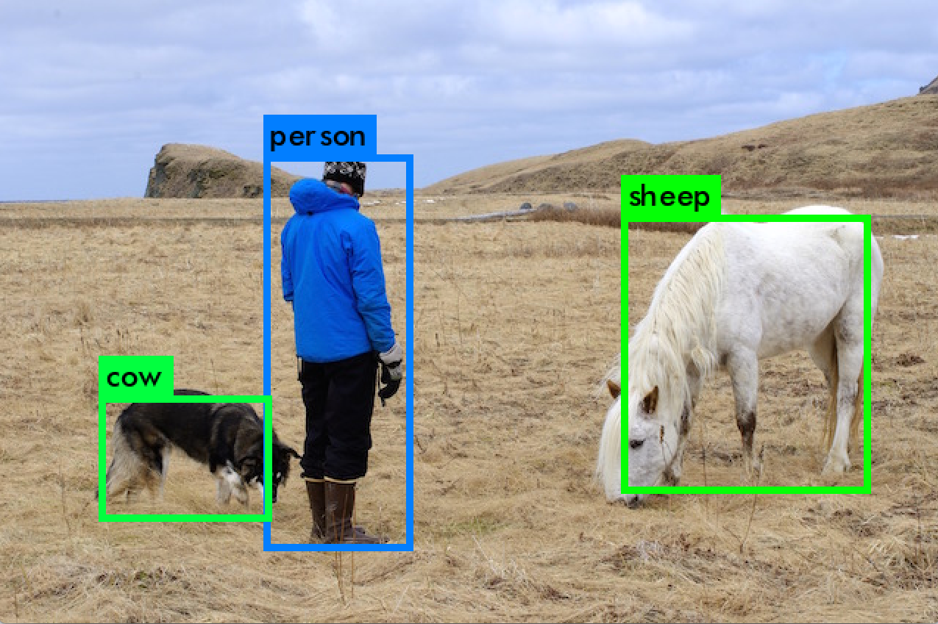
Representations and Models
Input space X?
Pixels in the image
Representation?
ɸ_{x}(X)=R^{W,H,3} RGB or HSV
Output space Y?
Object classes C + bboxes
Representation?
ɸ_{y}(Y) = C ✕ R^{x,y,w,h} ✕ N
What model architecture might you use?
What loss function would you want to optimize?

Slide 58
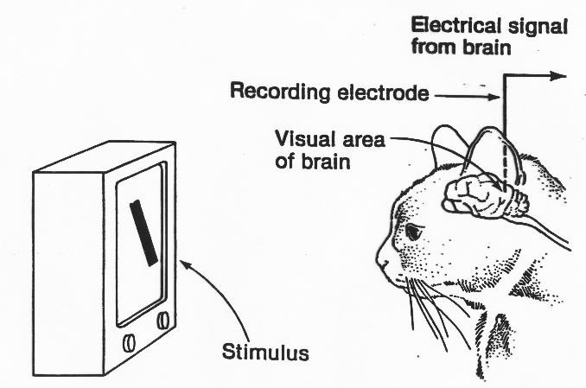
Origins of Convolutional Neural Networks
“They found that particular neurons in the visual cortexes of cats and monkeys—the areas in their brains responsible for processing visual information—didn't respond to simple points of light, but rather to lines, and in particular, lines and contours with specific orientations”
https://hub.jhu.edu/2015/07/14/golden-goose-award-wiesel-hubel/

Slide 59
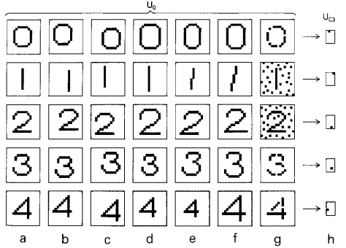
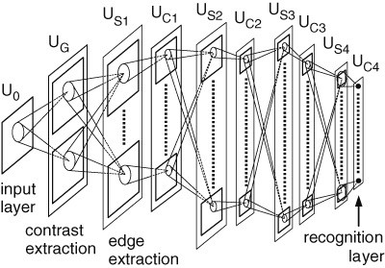
Origins of Convolutional Neural Networks
Fukushima, Kunihiko. Neocognitron: A self-organizing neural network model for a mechanism of visual pattern recognition. Competition and cooperation in neural nets 1982.

Slide 60
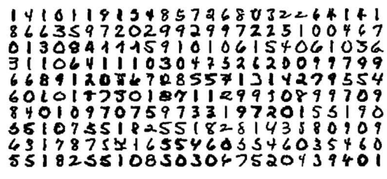
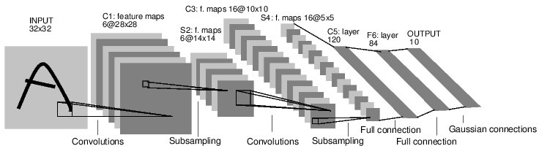
Origins of Convolutional Neural Networks
Y. LeCun, et. al. Handwritten digit recognition with a back-propagation network. NeurIPS 1989.

Slide 61
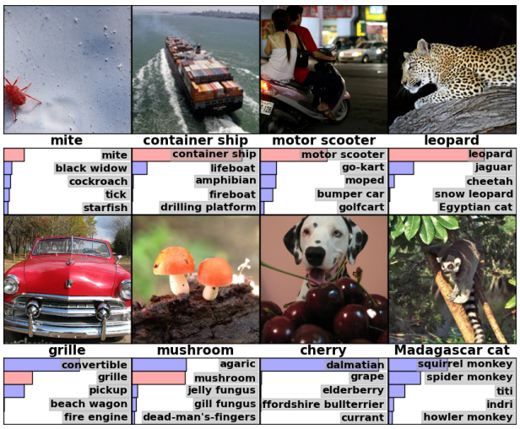
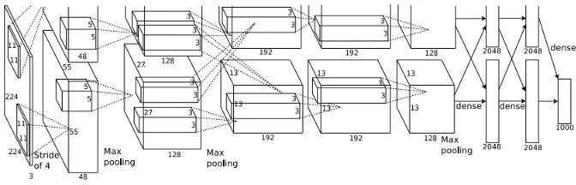
Origins of Convolutional Neural Networks
A Krizhevsky, et. al. ImageNet Classification with Deep Convolutional Neural Networks. NeurIPS 2012.

Slide 62































Breaking Down AlexNet
?

Slide 63

Breaking Down AlexNet
.01 | car
.03 | dog
.63 | person
.11 | airplane
.02 | flower
… | …
Image
Conv
Conv
Conv
Conv
Conv
FC
FC
FC+𝝈
Pool
Pool
Pool

Slide 64
Common Layers in a Deep Convolutional Neural Net
Image
x in our parlance; the vectorized input
Convolutional layer
Pooling layer (in AlexNet, MaxPool)
Fully-connected layer (i.e., perceptron layer)
Softmax layer (fully connected layer + exponentiated normalization)
Each layer is a differentiable function whose input is the output of the previous layer (function)
Conv
Pool
FC
FC+𝝈

Slide 65
What Are Our Options to Process an Image?
ɸ_{x}( ) = [0, 1]^{(w x h x 3)}
Input space X?
Image (e.g., PNG)
Representation?
ɸ_{x}(X)=R^{W,H,3} RGB
H
3
red, green, blue
W
Note: ɸ here is going to have to either crop or resize image inputs!

Slide 66
What Are Our Options to Process an Image?
ɸ_{x}( ) = [0, 1]^{(w x h x 3)}
Let w=h=300. Then our tensor representation of input images is size 300x300x3 = 270k individual [0,1] values.
Can we classify such an input using a linear model f(x) = Wx+b?
Yes!
We could use a fully-connected layer between the input tensor and a vector of output classes.
H
3
W

Slide 67
Image Classification with a Fully-Connected Layer
ɸ_{x}( ) = [0, 1]^{(w x h x 3)}
.01 | car
.03 | dog
.63 | person
.11 | airplane
.02 | flower
… | …
FC+𝝈
|C|
h
3
w
1
f(x) = 𝝈(Wx+b) ?

Slide 68
Image Classification with a Fully-Connected Layer
Fully Connected Layer
ɸ_{x}( ) = [0, 1]^{(w x h x 3)}
Quick recap: what’s learnable here?
|C|
h*w*3
.01 | car
.03 | dog
.63 | person
.11 | airplane
.02 | flower
… | …
f l a t t e n
|C|
(note how not-to-scale W is here)
+
|C|
h
*
h*w*3
3
w
What are we asking the network to learn? Will the loss go down?
1
1
1
f(x)=W x + b

Slide 69
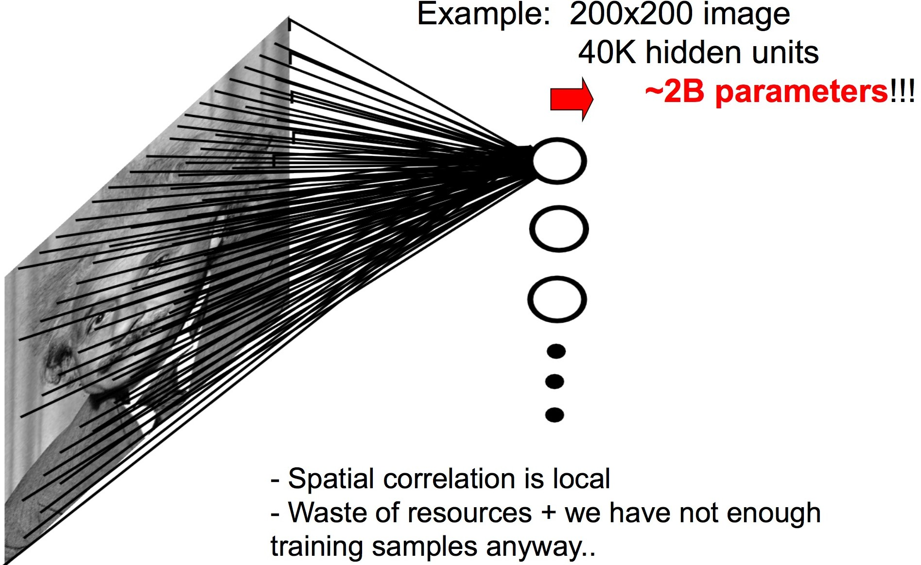
Image Classification with a Fully-Connected Layer
Let w=h=300. Then our tensor representation of input images is size 300x300x3 = 270k individual [0,1] values.
Then W is size |C| * 270k
For 1000-way classification, we’d be committing to learning a weight matrix with 270 million parameters
FC
What structural bias are we failing to utilize?
Flatten image to single vector x multiplied against learned weights W, add bias vector b

Slide 70
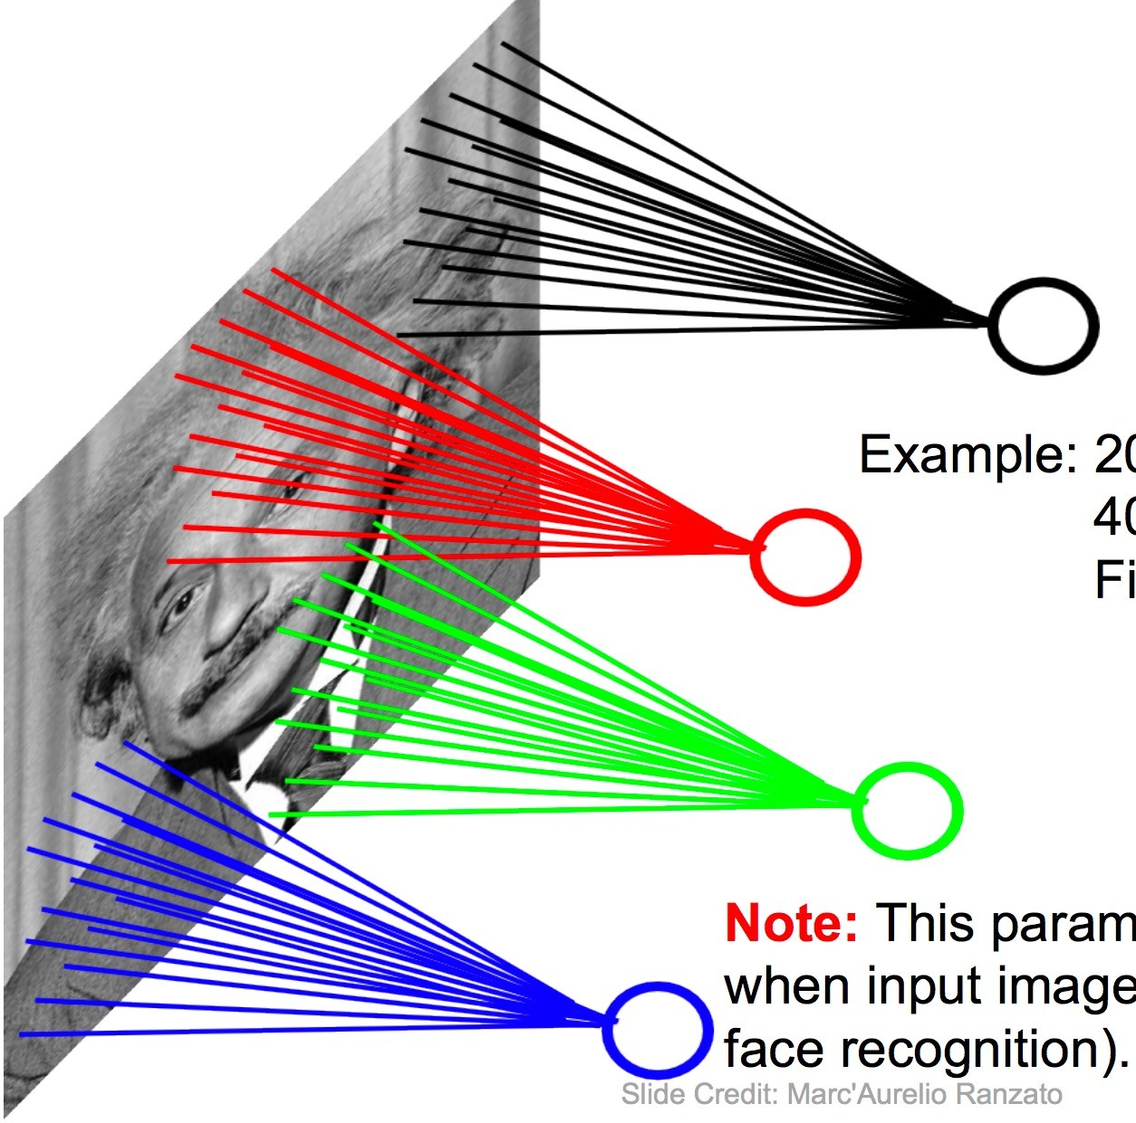
Structural Bias: Image Pixels Have Spatial Relationships
When we flatten an image, we assume every pixel contributes independently to the final class
We can instead learn a function of a neighborhood of pixels which are spatially co-located
Each such function is called a convolutional filter
FC

Slide 71
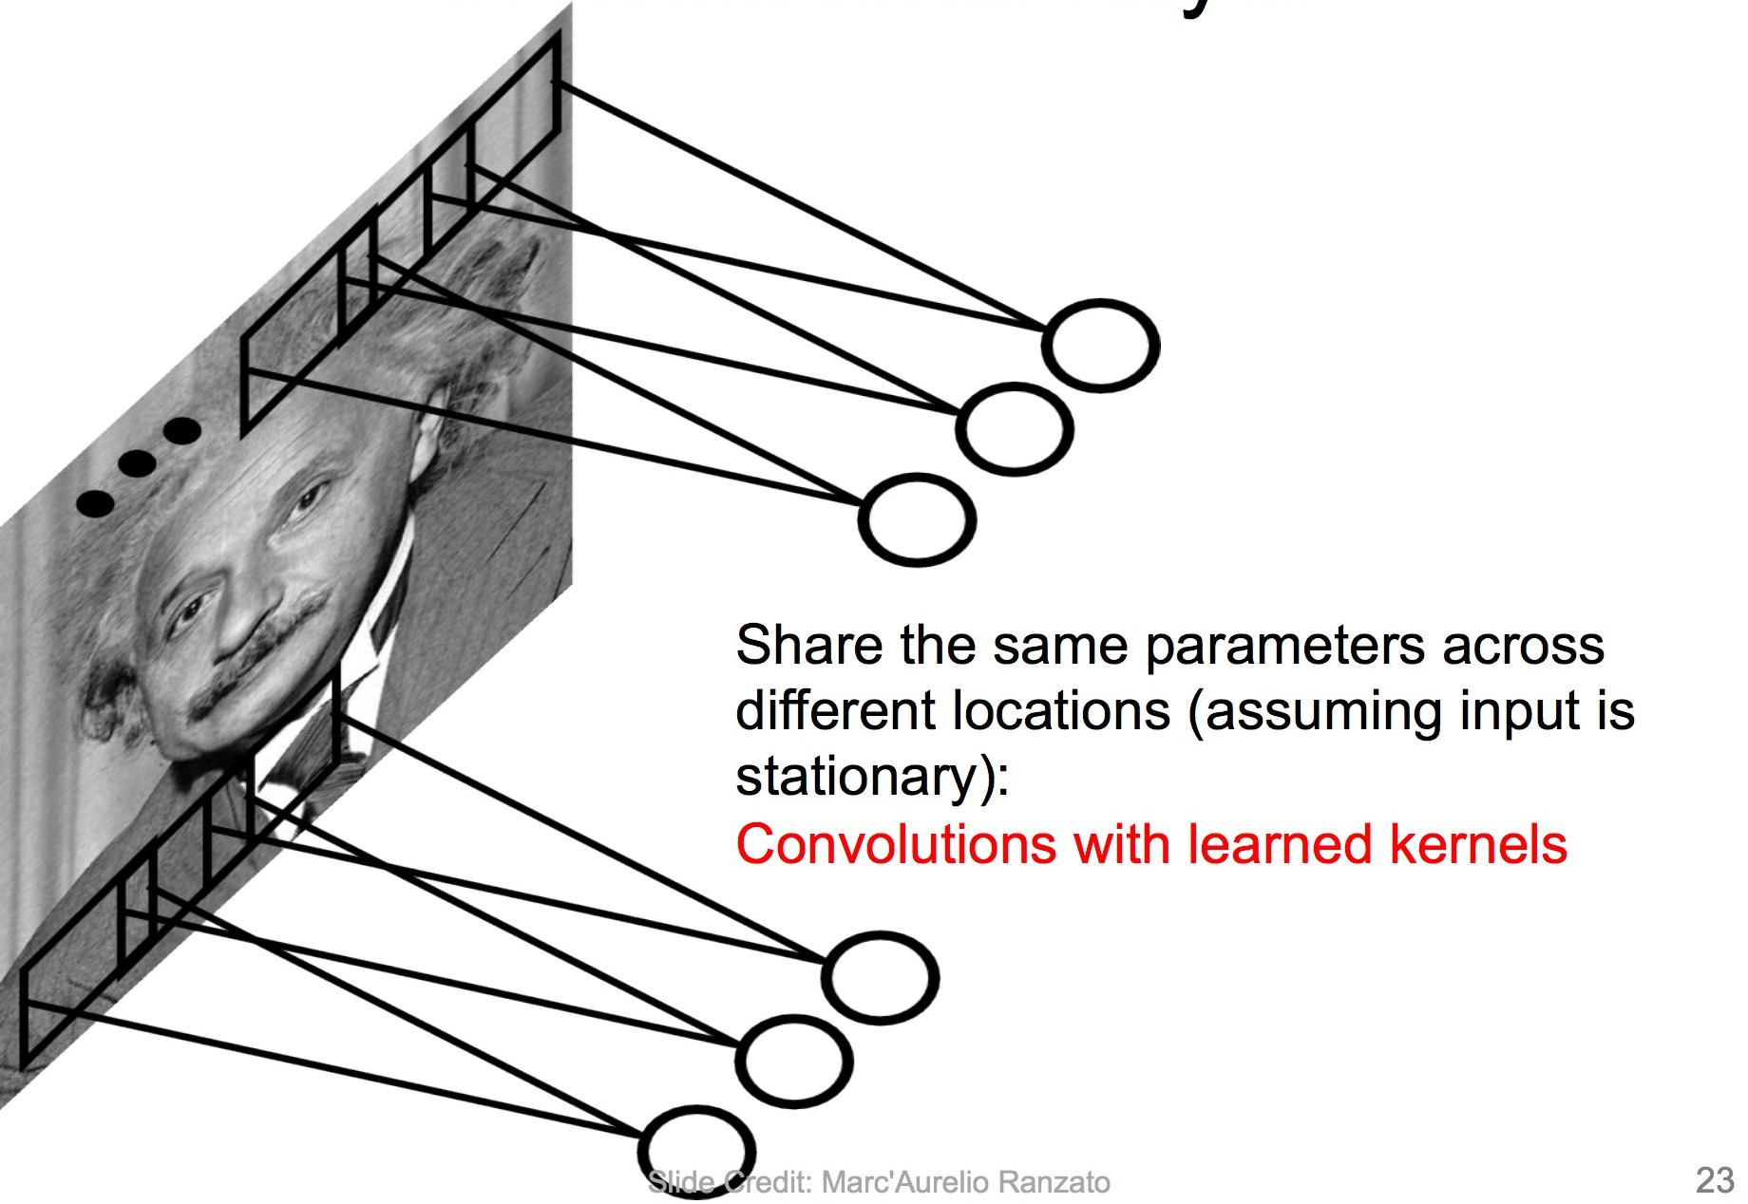
Structural Bias: Image Pixels Have Spatial Relationships
A filter can be applied and learned across multiple neighborhoods by applying it with a stride
A convolutional layer applies multiple learnable filters with a given kernel size and stride length
Kernel size: how tall/wide/deep the filter input is
Stride length: how many indices to move in each dimension between applications of the kernel (e.g., 1)
FC

Slide 72
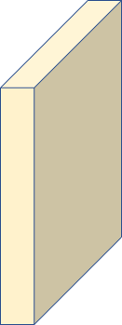

Convolutional Layer
Convolutional layer filter. Kernel? Stride?
5x5x3 kernel
Stride yet to be decided
32
5
32
5
ɸ_{x}( ) = [0, 1]^{(32 x 32 x 3)}
3
3
Image tensor x
Contains all the information in the image.

Slide 73

Convolutional Layer
5
5
As we slide 5x5x3 over input of size 32x32x3, we get an output of 28x28x1. So what’s the stride?
f_{c}(x_{A}) = Wx_{A}+b
3
x_{A}
28
32
28
32
ɸ_{x}( ) = [0, 1]^{(32 x 32 x 3)}
1
Stride=1. We “lose” 4 values where the filter would be hanging over the edge of the input in width/height with kernel 5x5x3
x_{A} is a 5x5x3 subset of image tensor x
Filter function f_{c} a learned, linear function over flattened x_{A}
W is 1x(5*5*3), b is size 1, so f_{c} is a single number!
3

Slide 74
Convolutional Layer
f_{c}(x_{A}) = Wx_{A}+b

Slide 75
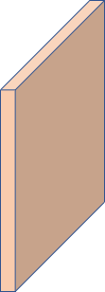



Convolutional Layer
x_{A}
28
32
28
32
ɸ_{x}( ) = [0, 1]^{(32 x 32 x 3)}
1+1+1+1=4
1
f_{c1}(x_{A}) = W₁x_{A}+b₁
3
Conv
f_{c2}(x_{A}) = W₂x_{A}+b₂

Slide 76
Convolutional Layer Filters
“They found that particular neurons in the visual cortexes of cats and monkeys—the areas in their brains responsible for processing visual information—didn't respond to simple points of light, but rather to lines, and in particular, lines and contours with specific orientations”
f_{c1}
f_{c1}(x_{A}) = W₁x_{A}+b₁
0.7 | 1 | 0
0.3 | 1 | 0.3
0 | 1 | 0.7
https://hub.jhu.edu/2015/07/14/golden-goose-award-wiesel-hubel/

Slide 77
Convolutional Layer Filters
f_{c1}
Learned CNN Filter
0.7 | 1 | 0
0.3 | 1 | 0.3
0 | 1 | 0.7
f l a t t e n
9
1
*
+
1
3
<0.7, 1, 0, 0.3, …>
9
1
1
1
What kind of input creates a high response from this filter?
3
f_{c1}(x)=W₁ x_{A} + b₁

Slide 78
Convolutional Layer Terminology
3D Tensor
Kernel
Stride
width
height
(width, height, channels)
Stride 1
channels
Stride 3

Slide 79
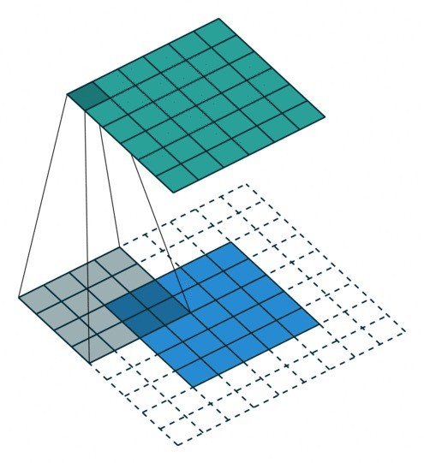
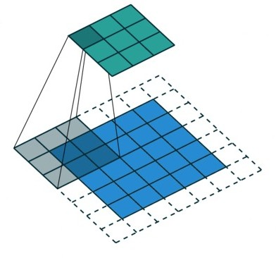
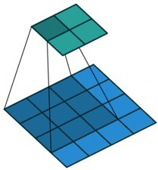
Convolutional Layer Terminology
Padding and Stride
Pad=0; Stride=1
Pad=2; Stride=1
Pad=1; Stride=2
Kernel size?
What to pad with?
Effect of stride?
3x3; lose 2 w/h
Zeros common
Sparser output

Slide 80
Image Classification with a Convolutional Layer
ɸ_{x}( ) = [0, 1]^{(w x h x 3)}
.01 | car
.03 | dog
.63 | person
.11 | airplane
.02 | flower
… | …
w’
w
FC+𝝈
|C|
h
h’
4
3
Conv
1

Slide 81
Common Layers in a Deep Convolutional Neural Net
Image
x in our parlance; the vectorized input
Convolutional layer
Pooling layer (in AlexNet, MaxPool)
Fully-connected layer (i.e., perceptron layer)
Softmax layer (fully connected layer + exponentiated normalization)
Conv
Pool
FC
FC+𝝈

Slide 82
Pooling Layer
A pooling layer shrinks a tensor along specified dimensions by removing information
Condense information for a given neighborhood using an operator such as:
Max
Min
Average
L2-norm
w
w’
h’
h
3
3
Pool

Slide 83
Pooling Layer
f_{p}(x_{A}) = p(x_{A})
p is a function with no learnable parameters
E.g., max

Slide 84
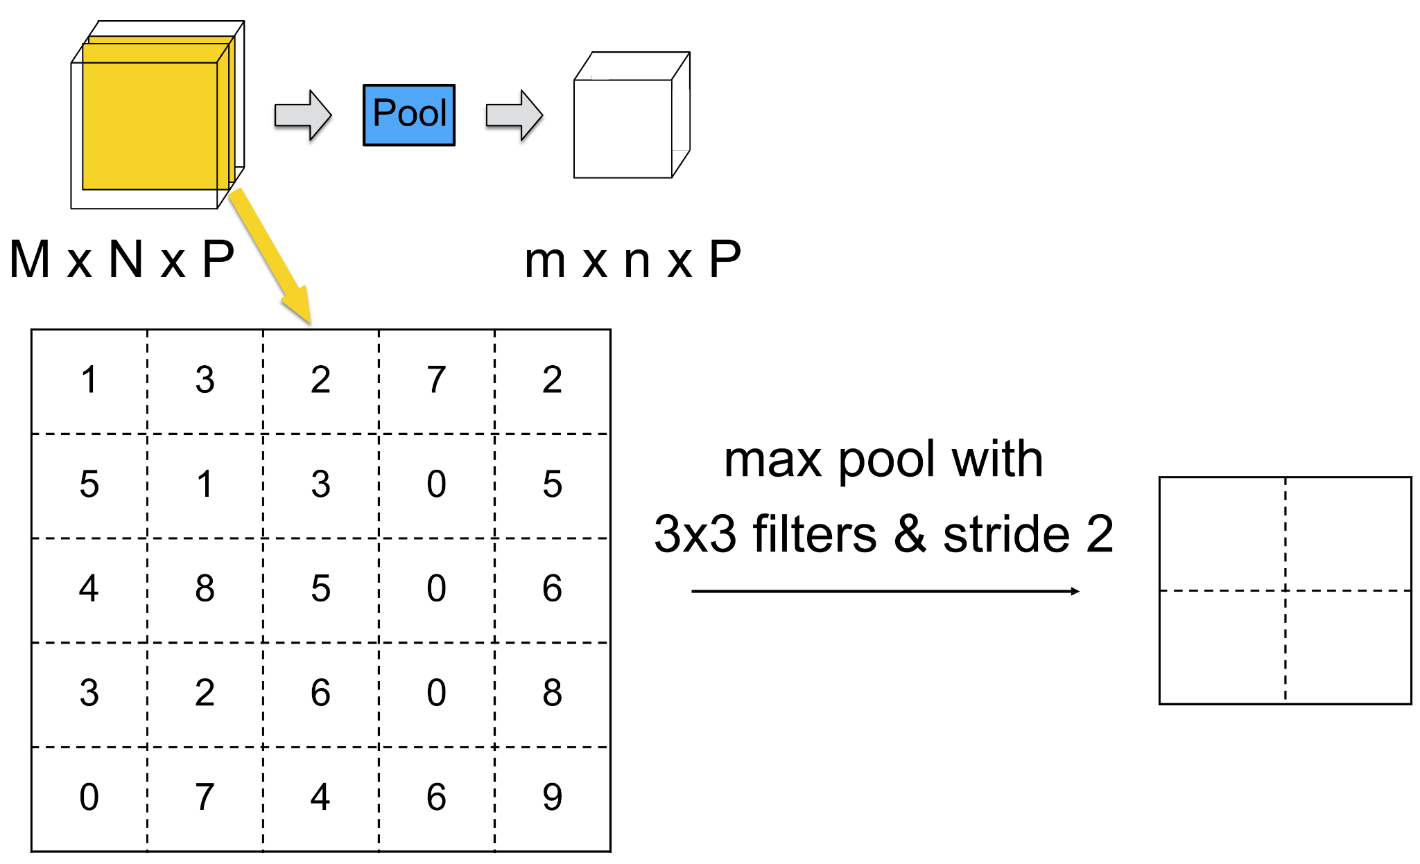
Max Pooling Layer

Slide 85

Max Pooling Layer

Slide 86

Max Pooling Layer

Slide 87

Max Pooling Layer

Slide 88

Max Pooling Layer

Slide 89

Max Pooling Layer

Slide 90
Image Classification with a Conv and Pool Layers
ɸ_{x}( ) = [0, 1]^{(w x h x 3)}
|C|
.01 | car
.03 | dog
.63 | person
.11 | airplane
.02 | flower
… | …
w’
w
h’
w’’
W^{(|C| x w’’*h’’*4)}
h
Conv
Pool
FC+𝝈
h’’
4
4
3
1

Slide 91
With These Layers, We Can Compose AlexNet!
Image
Conv
Conv
Conv
Conv
Conv
FC
FC
FC+𝝈
Pool
Pool
Pool

Slide 92


What Does AlexNet Learn?
Image
Conv
Conv
Conv
Conv
Conv
FC
FC
FC+𝝈
Pool
Pool
Pool
Network Dissection: Quantifying Interpretability of Deep Visual Representations, CVPR’17

Slide 93


What Does AlexNet Learn?
Image
Conv
Conv
Conv
Conv
Conv
FC
FC
FC+𝝈
Pool
Pool
Pool
Network Dissection: Quantifying Interpretability of Deep Visual Representations, CVPR’17

Slide 94


What Does AlexNet Learn?
Image
Conv
Conv
Conv
Conv
Conv
FC
FC
FC+𝝈
Pool
Pool
Pool
Network Dissection: Quantifying Interpretability of Deep Visual Representations, CVPR’17

Slide 95


Other Formerly Popular Image Classification Architectures
Very Deep Convolutional Networks for Large-Scale Image Recognition Deep Residual Learning for Image Recognition

Slide 96
Overview of Today’s Plan
Course organization and deliverables
Training Neural Networks
Convolutional Neural Networks
Any questions before we move on?

Slide 97
Action Items for You
If you have gotten D-clearance but have not taken Quiz 0, please take it; it is just a survey for us to get a sense of the student body, but it is worth points!
Form project teams; these must be registered today
Start brainstorming project topics; take a look at the deck of project ideas to get an idea what info you’ll need if your team scopes a novel proposal

Slide 98
CSCI 566: Deep Learning and Its Applications
Jesse Thomason
Lecture 3: Training NNs; CNNs

